Slide 1
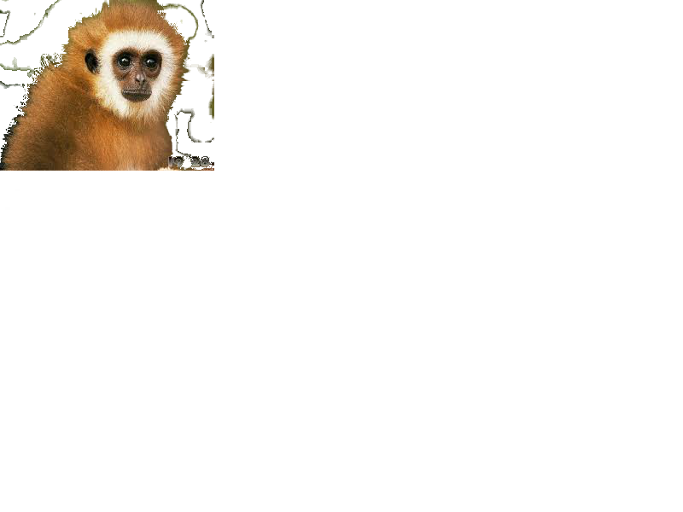
The Monkey Who Liked To Dance!
BY: Madalynn Kusch

Slide 2
Once there was a monkey named George. George loved to dance. But in George’s part of the jungle dancing was forbidden. All the other monkeys liked to sing. George felt left out. He took a walk to clear his head.
LALALALAALALALA

Slide 3
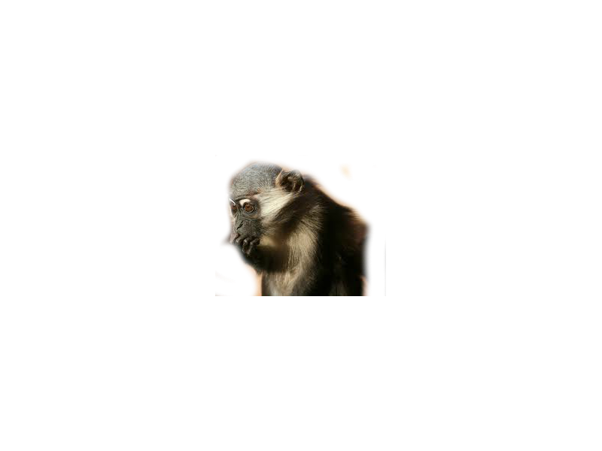
George felt lonely and went back to his part of the jungle. George knew he couldn’t sing. But he also knew that the other monkeys couldn’t dance. When he got back to his part of the jungle he decided to tell the other monkeys he could dance. George was nervous!

Slide 4
Once he told all the other monkeys even the head monkey, Francis. Francis said that dancing was a waste of time. George said that dancing is the only thing he is good at. George was really sad. Francis was ashamed of George.

Slide 5
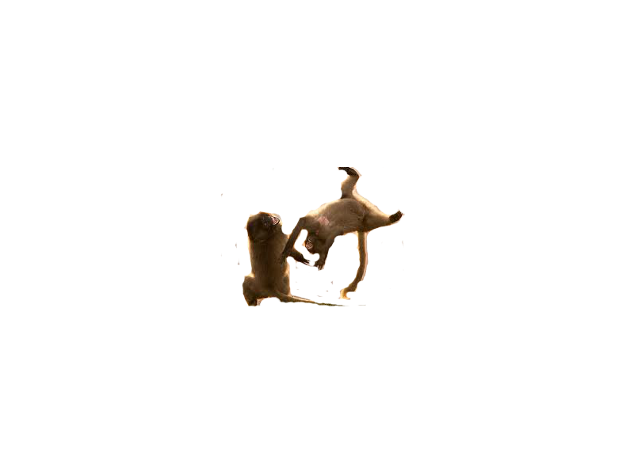
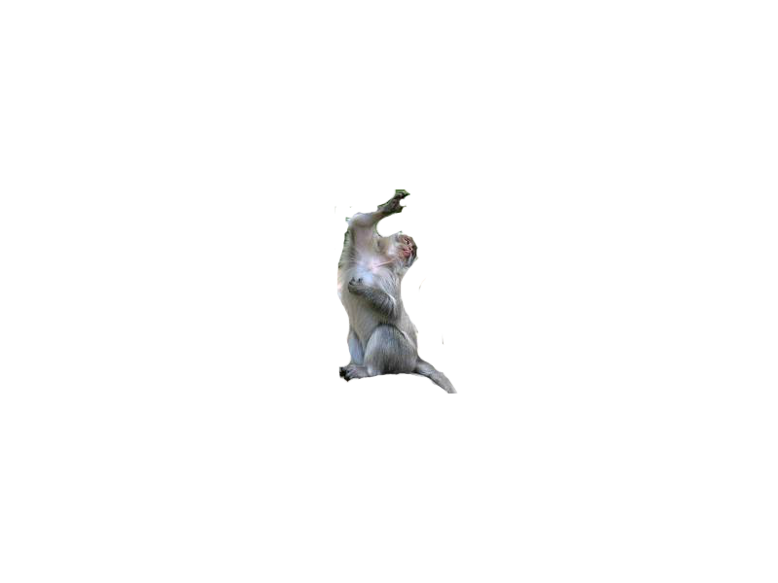
It was the next day and George went to Francis and told him he was sorry. Francis asked George to teach him how to dance! George was surprised! So George taught Francis how to dance. George and Francis danced all night.

Slide 6
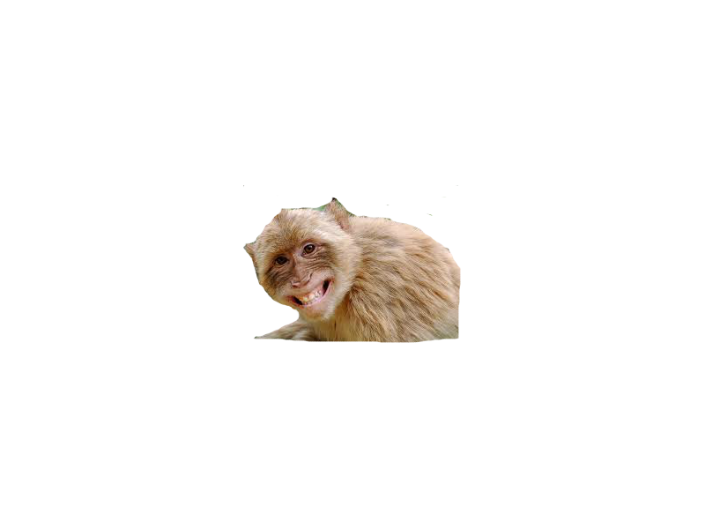
When Francis and George were done dancing Francis said that George should tell the other monkeys he could dance. George was a little scared but he agreed. George told the other monkeys he could dance. They were shocked! They were happy!!
WHAT!!

Slide 7
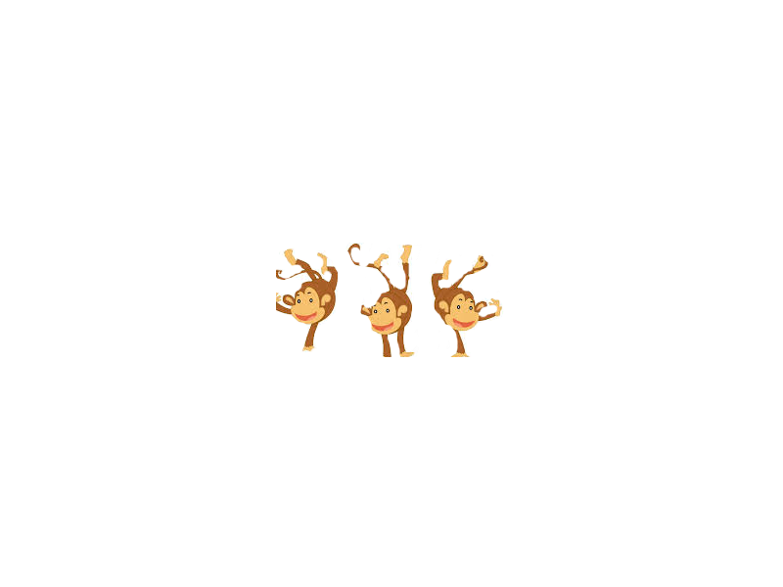
In the end Francis threw a surprise dancing party! George also learned to be himself. In the end everyone was happy and dancing.

Slide 8
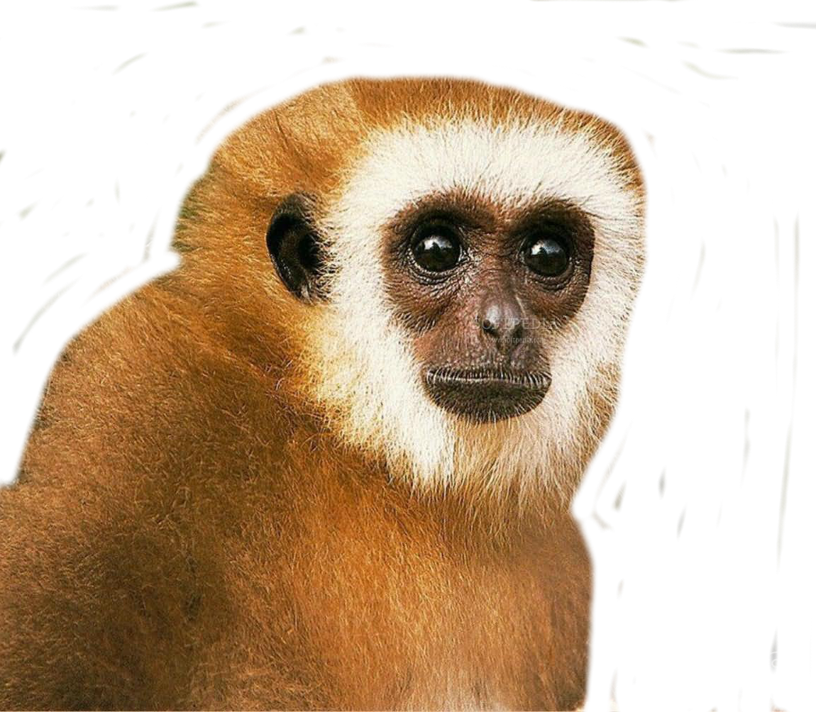
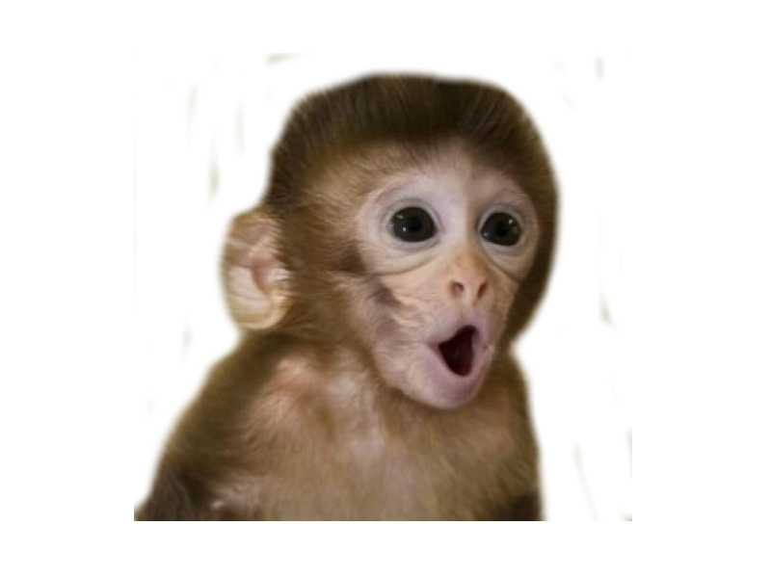
Credits
Photos edited by: Madalynn Kusch
Story Written By: Madalynn Kusch

